Slide 1
MOS Gates

Slide 2
Terminal Voltages
Mode of operation depends on V_{g}, V_{d}, V_{s}
V_{gs} = V_{g} – V_{s}
V_{gd} = V_{g} – V_{d}
V_{ds} = V_{d} – V_{s} = V_{gs} - V_{gd}
Source and drain are symmetric diffusion terminals
By convention, source is terminal at lower voltage
Hence V_{ds} ≥ 0
nMOS body is grounded. First assume source is 0 too.
Three regions of operation
Cutoff
Linear
Saturation

Slide 3
nMOS Cutoff
No channel
I_{ds} ≈ 0

Slide 4
nMOS Linear
Channel forms
Current flows from d to s
e⁻ from s to d
I_{ds} increases with V_{ds}
Similar to linear resistor

Slide 5
nMOS Saturation
Channel pinches off
I_{ds} independent of V_{ds}
We say current saturates
Similar to current source

Slide 6
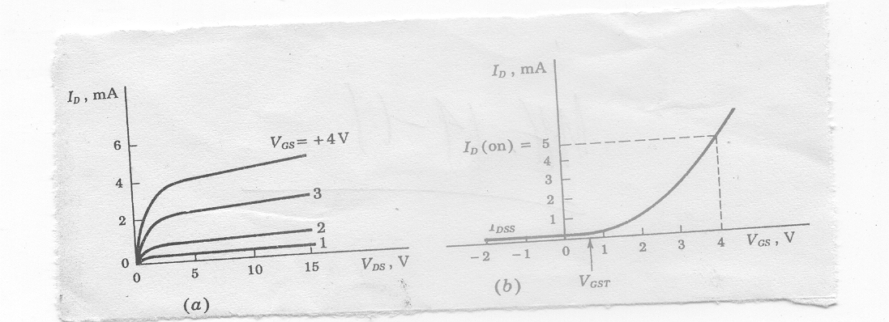
I-V Characteristics
I_{ds} is dependent on both V_{ds} and V_{gs}
In Linear region, I_{ds} depends on
How much charge is in the channel?
How fast is the charge moving?

Slide 7
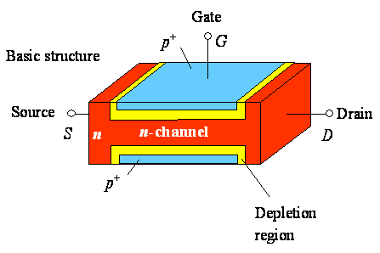
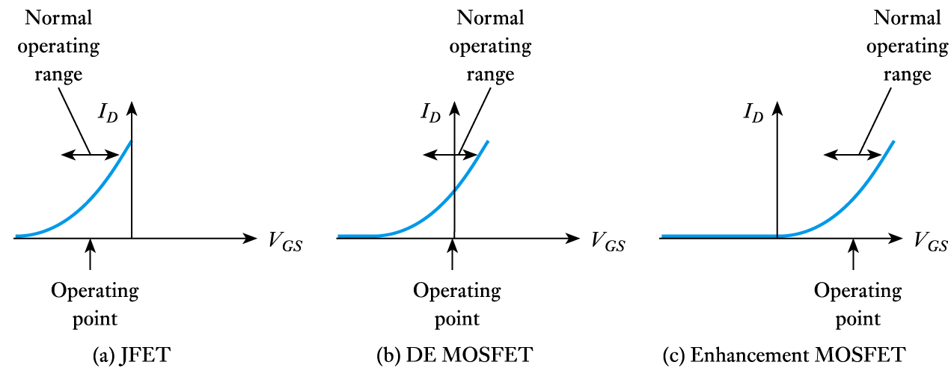
Transfer characteristics (n channel FET)
D
G
S
Operating range decides the type of FET

Slide 8
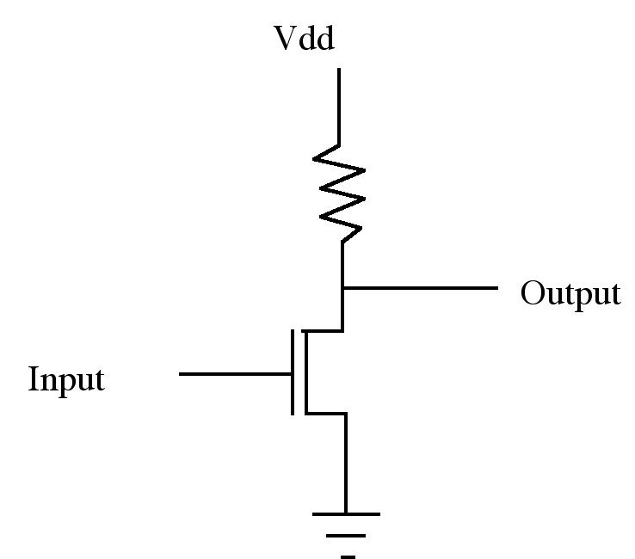
NMOS Inverter
Enhancement NMOS: (a) I_{D} versus V_{DS} (b) I_{D} versus V_{GS}
Inverter Operation
- Plus signal input turns transistor on
- Ground is connected to output, thus a 1 (+) in gives 0 (Gnd) out
- A 0 input opens transistor and output is pulled high by resistor

Slide 9
NMOS Inverter
Resistor dissipates heat
Fabrication of resistor is not easy
Even modest values of Resistors occupy excessively large areas in silicon substrate

Slide 10
A transistor may be used as a resistor
V_{DD}
Pull up
Output
Input
Pull down
In Pull down NMOS
For input=1, Pull down conducts
For input =0, Pull down is off

Slide 11
V_{DD}
Pull up as an enhancement type NMOS
Pull up transistor input (V_{GG}) should be high
V_{GG}
Pull up
Output
Input
Pull down

Slide 12
Pull up as an enhancement NMOS
V_{out}
V_{DD}
V_{DD}
V_{tpu}
V_{GG}
Pull up
Output
Input
Pull down
Non zero output
V_{tpd}
V_{in}
Dissipation is high since current flows when input=1
V_{out} can never be zero
V_{out} can never reach VDD (logical 1) if V_{GG}=V_{DD} as is normally the case
If V_{GG} is higher than V_{DD}, then an extra rail is required

Slide 13
Depletion type NMOS is used in pull up for better performance
V_{DD}
Gate and Source is shorted to achieve V_{GS}=0
In Pull down NMOS
For input=1, Pull down is on
For input =0, Pull down is off
Pull up is always on
Output
Input

Slide 14
Depletion type NMOS is used in pull up for better performance
V_{DD}
V_{out}
V_{DD}
No current
Output
Current flows
Input
Non zero output
V_{tpd}
V_{in}
Dissipation is high since current flows when input=1
V_{out} can never be zero

Slide 15
Drawbacks of Metal-gate MOS Transistors
High current flow for input at logic 1 in case of an inverter
Excess surface state charges and mobile ion contamination cause the threshold variation.
V_{out} never becomes exactly zero
Suffer from excessive overlap capacitance.
Parasitic capacitances C_{gs} and C_{gd} slow the transistor because they must be charged and discharged during switching.
Aluminum is used as gate material which can erode completely causing contact spiking.

Slide 16
Complementary MOS Transistors (CMOS)
V_{DD}
p
When A is pulled high (V_{DD}), the PMOS inverter is turned off, while the NMOS is turned on pulling the output down to V_{SS}
When A is pulled low (V_{SS}), the NMOS inverter is turned off, while the PMOS is turned on pulling the output up to V_{DD}
A
Y = A'
n
GND

Slide 17
Complementary MOS Transistors (CMOS)
V_{out}
V_{DD}
V_{DD}
p
p on
n off
n on
p off
A
Y = A'
Both on
n
GND
V_{tpd}
V_{in}
No current flow either for logical 0 or for logical 1 inputs
Full logical 1 and 0 levels are presented at output
For devices of similar dimension p-channel is slower than n-channel device

Slide 18
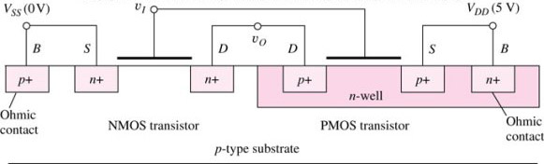
Complementary MOS Transistors (CMOS)
V_{DD}
S
G
p
D
A
Y = A'
D
n
G
S
GND

Slide 19
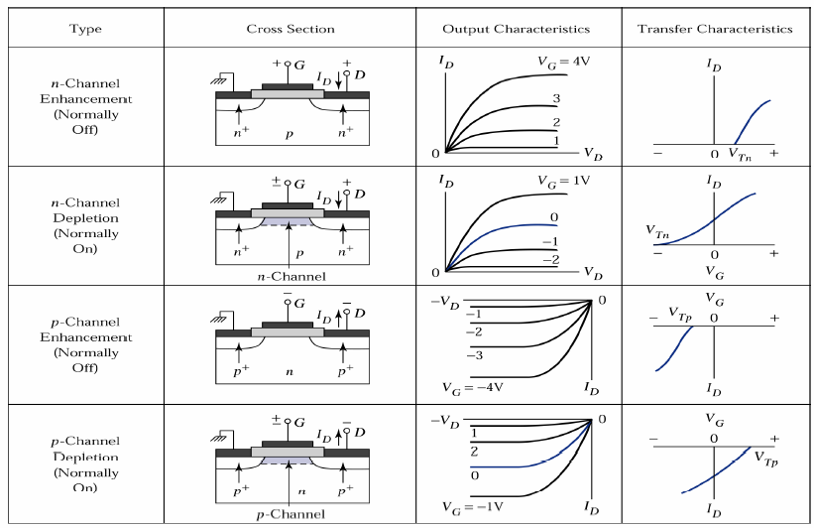
Types of MOSFET
Pullup may be enhancement type PMOS

Slide 20
CMOS Inverter Technology
Complementary MOS, or CMOS, needs both PMOS and NMOS devices for their logic gates to be realized
The concept of CMOS was introduced in 1963 by Wanlass and Sah, but it did not become common until the 1980’s as NMOS microprocessors were dissipating as much as 50 W and alternative design technique was needed
CMOS still dominates digital IC design today

Slide 21
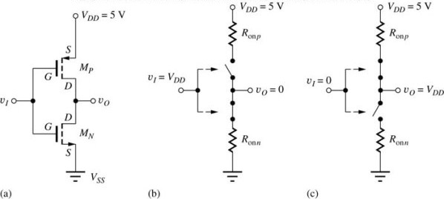
CMOS Inverter
Circuit schematic for a CMOS inverter
Simplified operation model with a high input applied
Simplified operation model with a low input applied

Slide 22
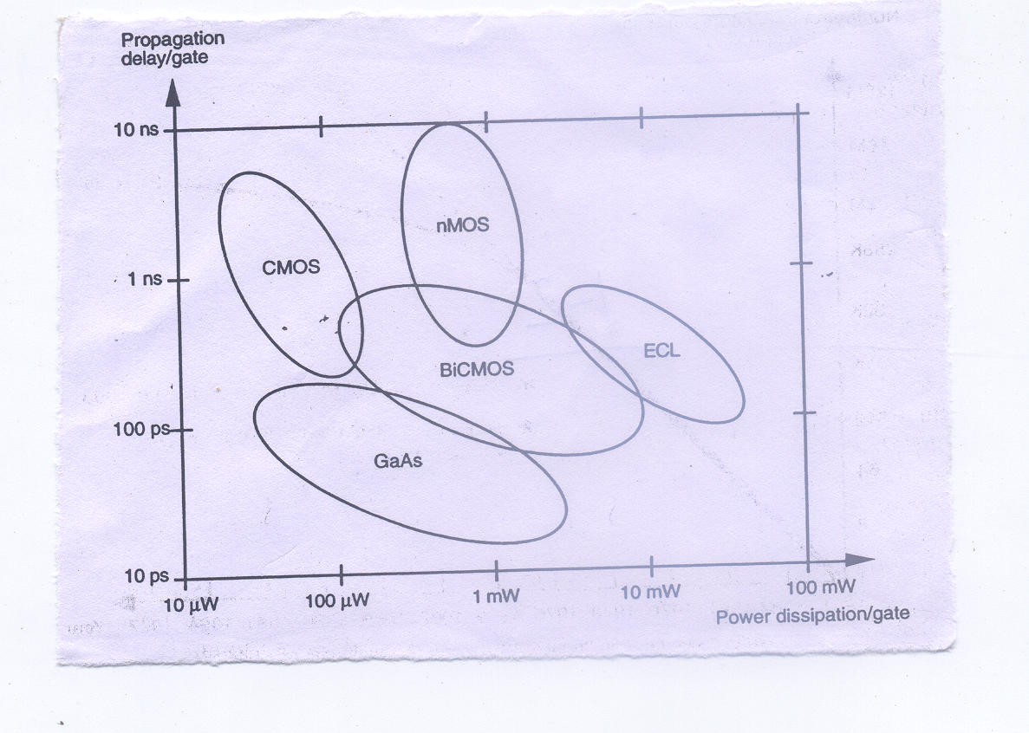
Speed / power performance of available technologies

